Slide 1

Predicting stock market Using MCMC
Sharada Sahoo

Slide 2
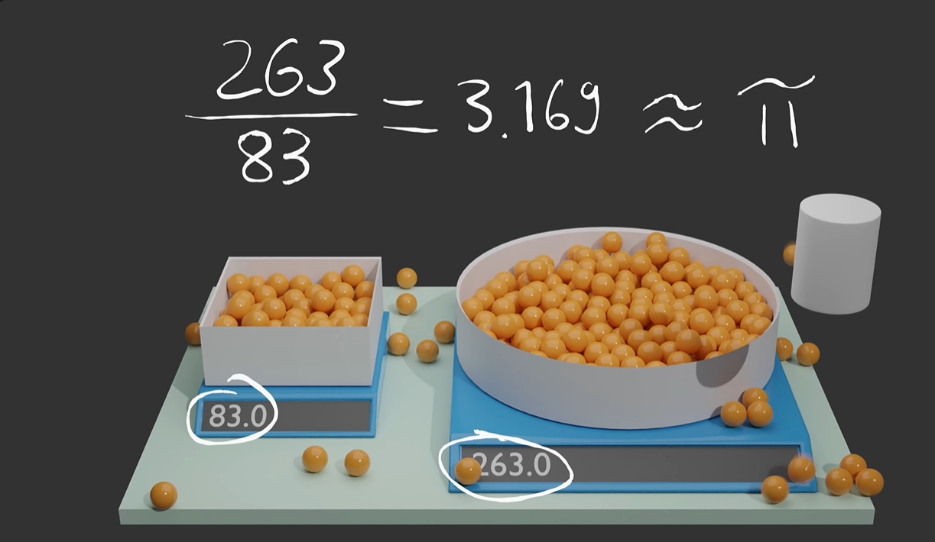
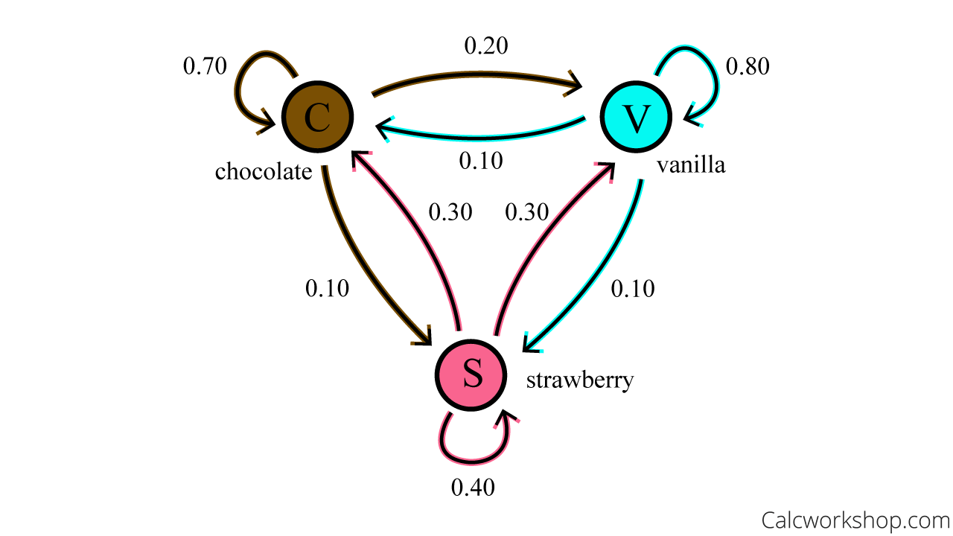
Monte Carlo & Markov chain
Monte Carlo
Markov Chain
Random sampling to find likelihood of a result
Sequence of events, with each state depends on its previous state.
Randomly balls are dropped over the podium, and dividing the number of balls inside the circle of radius “a” to inside the square of side “a”, we get the value of π.
For e.g: Probability of eating chocolate ice-cream depend on what flavour I ate last time.

Slide 3
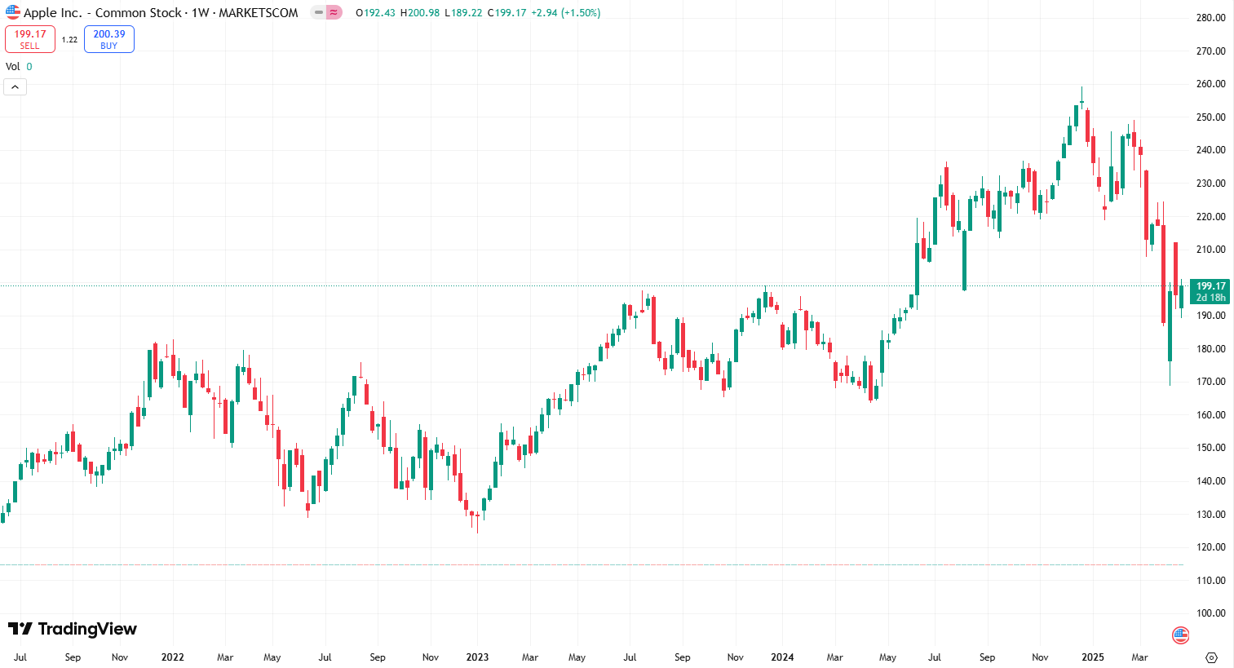
MCMC strategy

Slide 4
MCMC strategy
Stagnant
Up
Down

Slide 5
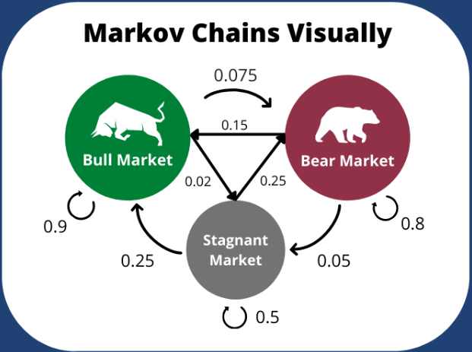
Results
Up
Stagnant
Down

Slide 6
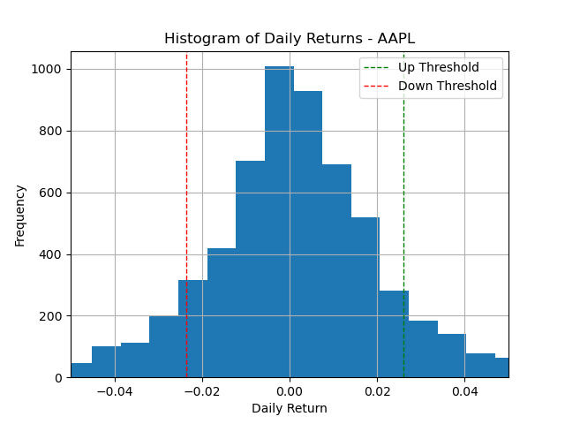
Workflow
Divide the market into different states
Find daily return percentage (DRP):
DRP_{i+1} = (Price_{i+1} - Price_{i})/Price_{i}*100
Find mean and sigma by fitting the histogram
Define
Up_threshold = mean + sigma
Down_threshold = mean - sigma
Define states:
Up = DRP > Up_threshold
Down = DRP < Down_threshold
Stagnant = Up_threshold < DRP < Down_threshold
https://medium.com/@simonleung5jobs/an-alternative-simulation-method-for-stock-price-forecasting-using-python-1bc1649edb99

Slide 7
Workflow
Find transition matrix - Future state - Future DRP
Find the probability from any current state to any future state. (transition matrix)
Estimate future state from the Transition matrix
Find the corresponding DRP depends on the future state
Future state
Up
Stagnant
Down
Transition matrix
Mu = mean + sigma
SIgma = sigma
Mu = mean
SIgma = sigma
Mu = mean - sigma
SIgma = sigma
 | Up/ Bullish | Down/ Bearish | Stagnant
Up/ Bullish | 0.9 | 0.025 | 0.075
Down/ Bearish | 0.15 | 0.8 | 0.05
Stagnant | 0.25 | 0.25 | 0.5
Draw a random sample from above distribution
Future DRP

Slide 8
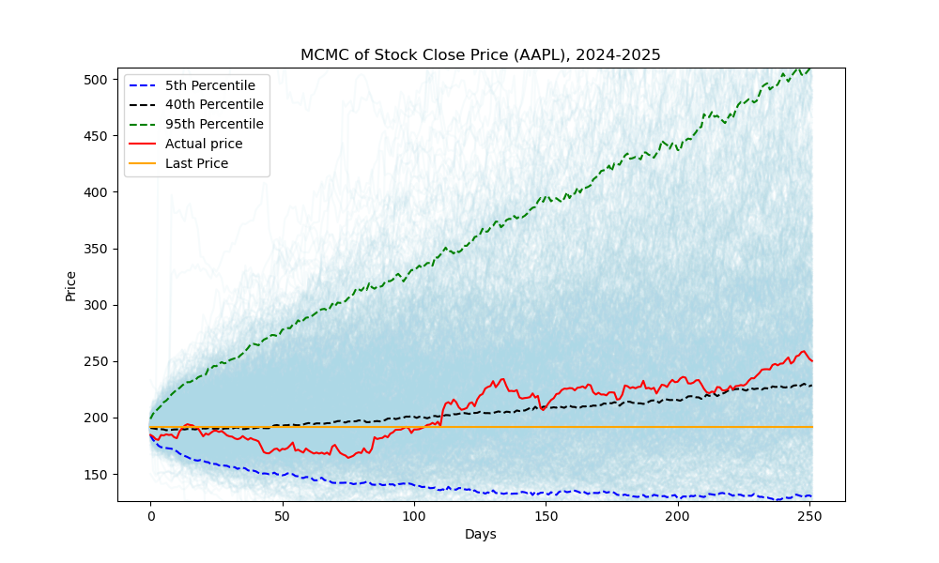
Results
Predicted growth = (Predicted_price - last_price) * 100
last_price
Actual growth = (Actual_price - last_price) * 100
last_price
Actual price for 2025
Prediction with 60 % probability
Last price for 2024

Slide 9
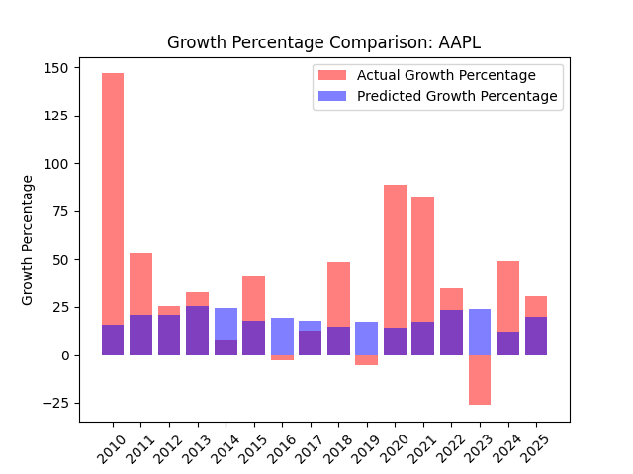
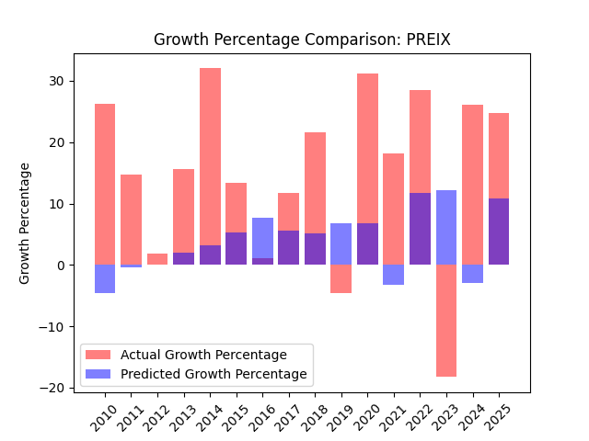
Results - Apple, PREIX mutual fund
After 16 years
Predicted growth = 1500 %
Actual growth = 9600 %
After 16 years
Predicted growth = 87 %
Actual growth = 757 %
Most times the prediction and actual price is in the same direction. Actual growth shows higher than predicted, giving higher return in total.
Does it predict so well for other stocks too??

Slide 10
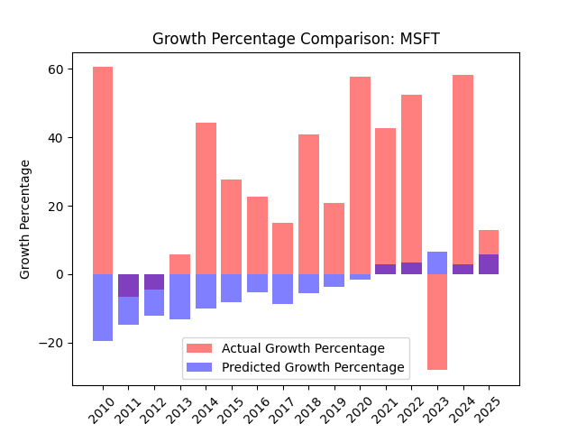
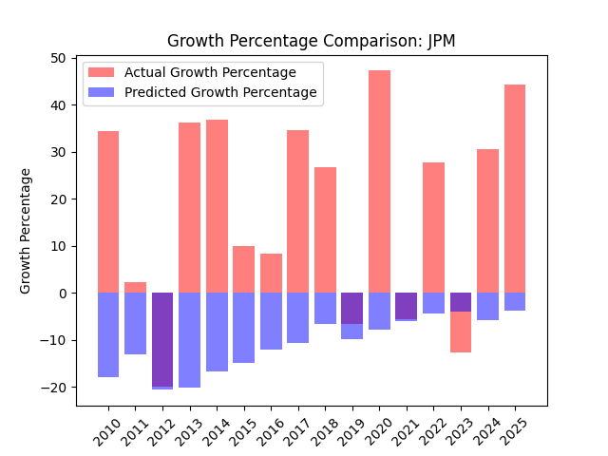
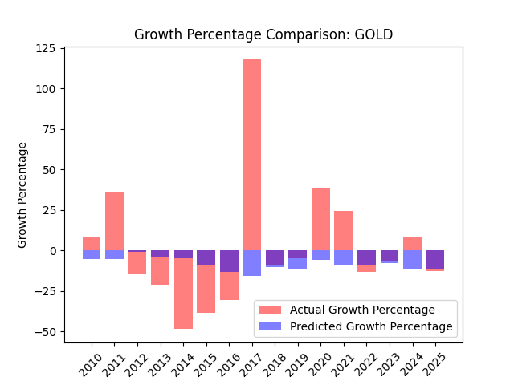
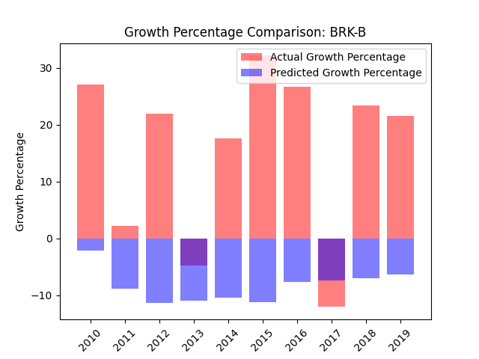
Anomaly

Slide 11
Further modification
Instead of single day in DRP, “n” number of days could be taken to find the the state of the market. “n” being the correlation of market state with number of days.
Instead of daily return percentage, other well studied indicators for market trend could be taken to estimate the state of the market.
Also prediction threshold was chosen 60 % here, some optimization could be done depending on various stocks.
Other models such as hidden markov model or machine learning could be implemented to predict the market growth.

Slide 12
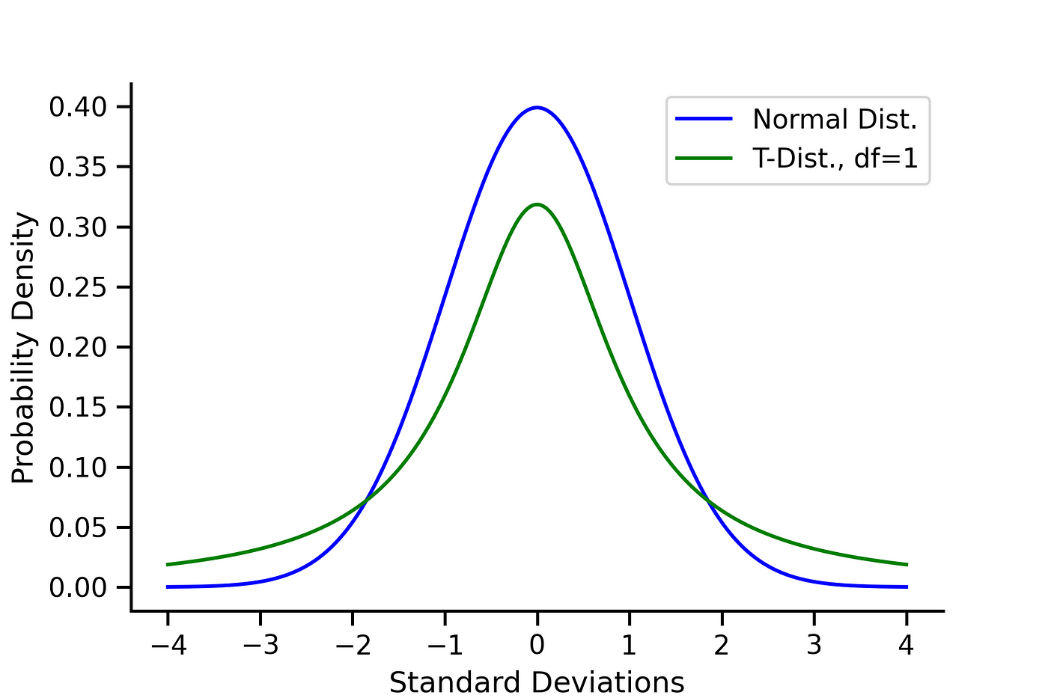
Student’s t distribution

Slide 13
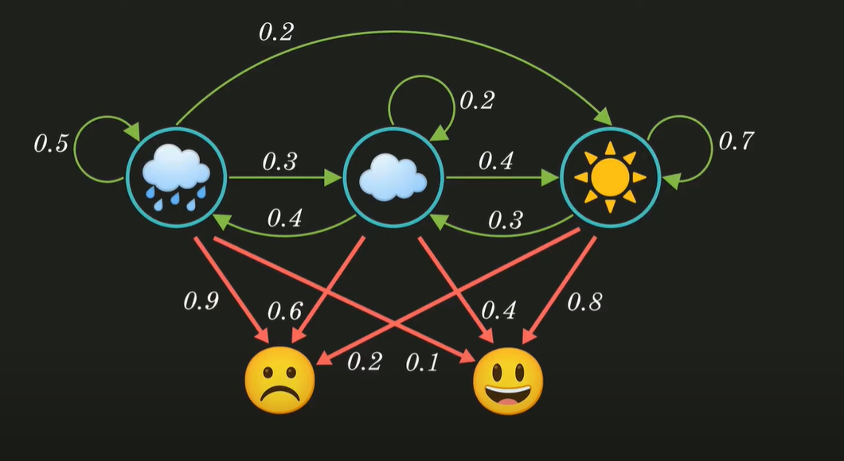
Hidden markov model
Markov chain is hidden
Getting to know about the markov chain from some observable parameters

Slide 14
Idea
Transition matrix
Daily return pdf
Today return percentage
Tomorrow state
Tomorrow return percentage
Current state

